Slide 1
Lecture 7: Exploratory Testing
Gregory Gay
DIT635 - February 10, 2021

Slide 2
Today’s Goals
Introduce Exploratory Testing
Human-driven testing of the project, to gain familiarity with the system and conduct high-level testing.
Often focused on “tours” of the software features.

Slide 3
Exploratory Testing
Testers check the system on-the-fly.
Guided by scenarios.
Often based on ideas noted before beginning.
Testing as a thinking idea.
About discovery, investigation, and role-playing.
Tests end-to-end journeys through app.
Test design and execution done concurrently.
Notes:
EXPLORATORY TESTING is a type of software testing where Test cases are not created in advance but testers check system on the fly. They may note down ideas or come up with goals about what to test before test execution. The focus of exploratory testing is more on testing as a "thinking" activity. Exploratory Testing is widely used in Agile models and is all about discovery, investigation, and learning. You can try out different roles and user types. It emphasizes personal freedom and responsibility of the individual tester.
Last week, we talked about system testing, this is a form of scripted testing where you design test cases first and later proceed with test execution. On the contrary, exploratory testing is a simultaneous process of test design and test execution all done at the same time. (last point)

Slide 4
Automation vs Human-Driven
Unit/System Testing heavily use automation.
Tests written as code.
Executed repeatedly, often on check-in.
Exploratory/Acceptance Testing often human-driven
Humans interact with app.
Based on scenarios, without pre-planned input.
Some tool support, but not often repeated exactly.
Notes:
Unit and integration testing - both subsystem and system-level - tends to be done by writing executable test cases in an appropriate framework. For example, unit testing is almost always written as small test methods. These tests should be run over and over and over again. This means that they need to be executable without human involvement. This is easy to do, and there are appropriate frameworks for writing, running, and automating execution of tests for almost every language out there. Exploratory testing and acceptance testing are more often human-driven, with some tool support for recording what you did and capturing information about failures detected during the process. Exploratory and acceptance tests are less likely to be repeated in the exact same way. However, there are tools, like what we call capture and replay tools, that can capture human interactions and repeat them. Exploratory and acceptance testing are often based on pre-planned scenarios, rather than highly-specific input, and humans fill in the gaps using their intuition, often repeating scenarios with minor changes.

Slide 5
Exploratory Testing
Tester write down ideas to give direction, then create tests “live”.
Tester chooses next action based on results seen.
Can find subtle faults missed by formal testing.
Allows tester to better learn system functionality, and identify new ways of using features.
Notes:
The tester will create or write down a test idea to give direction, and explore the system while testing to further create critical, practical and useful tests for the successful testing of an application. This requires minimal planning. Testers continuously make a decision on her next step of action. It completely depends upon the tester's thought process.
Sometimes this testing can be more beneficial than the formal testing approach for finding some subtle defects which go missing in formal testing.
A learner will learn better through hands-on experience rather than cramming the theory. Likewise, a tester will know the application better only while exploring and learning about all the functionality it provides by itself. It is always good to have a customer and business perspective while testing to ensure successful testing of an application.
For Example, if you open a shopping website, you have a general idea that this shopping website will let you shop by selecting a product of your choice and then paying for the same.
During this process, you might learn that you can order a number of products for home trial or that you can make payment through rewards points of some banks, etc. You can extend your testing to try these featurs.
As a tester, you not only need to verify whether a system is working as expected but also check if that system is not behaving in a way which is not expected. Exploratory testing can help find these gaps.

Slide 6
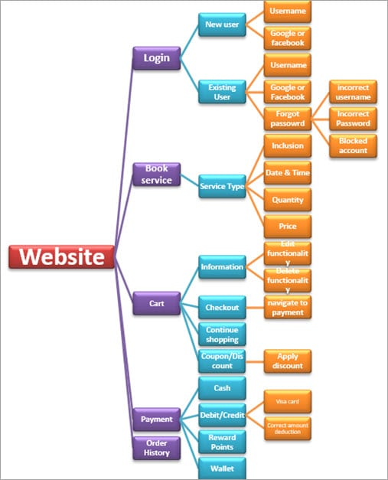
Example
Start with functionality you know well (Login)
Examine possible options and list them.
Use your findings to plan the next steps.
As you learn and observe, more test cases will emerge.
Some slides derived from https://www.softwaretestinghelp.com/what-is-exploratory-testing/
Notes:
A home care service provider website with the following components: Login, Services, Cart, Payment, Order History, Technician allotment. A general idea to start exploratory testing will be to Login or book a service.the idea is to start with functionality based on your knowledge. As you learn and observe more about the application, you can govern your next set of test cases. (go over diagram - > start with login feature, then what are our options? well, we could try creating a new user or we could log in as an existing user. As a new use, you can enter a username or use Google/Facebook integrated login to create an account using your Google or Facebook account. If we are existing user, can login using username (... go down chart)

Slide 7
Session-Based Exploratory Testing
Time-based method to structure exploratory testing.
Conducted with no e-mail, phone, messaging.
Short (60min), Normal (90m), Long (120m)
Primary components:
Mission
The purpose of the session.
Provides focus for the tester.
Charter
Individual testing goals to be completed in this session.
Could be a list of features or scenarios.
Notes:
While doing exploratory testing, it’s very difficult for testers to put into words on how much he has tested and on what basis. it’s difficult to quantify the work and the time spent. Session-based testing is a time based approach to perform this testing which helps in managing, tracking, and keeping exploratory testing on track. It includes a dedicated time-boxed testing session with no interruption from email, phone, messages etc. Each session can have the following duration: “Short” (60min) “Normal” (90min) “Long” (120 min). Primary components: Mission: Mission shout out the purpose of the session and in a way provide the focus for the tester. It will also include a session time duration. Charter: Includes the scope of the testing. Basically, an agenda detailing the goals that need to be completed during the session.

Slide 8
Session Report Items
Mission: Overall goal
“Analyze Login Feature on Website”
Charter: Features and scenarios to focus on.
“Login as existing user with username and password”
“Login as existing user with Google account”
“Login as existing user with Facebook account”
“Enter incorrect username and password to verify validation message”
“Block your username and verify the validation message”
“Use Forgot Password link to reset password”
Notes:
This process produces a session report that Include notes to provide metrics to the leaders and managers. It gives details about the charter sessions remaining or done, session setup time, scenarios tested, information about the testing process, a list of bugs and the issues found and other information. (go over items)

Slide 9
Session Report Items
Start and end time of session
Duration of session
Testing notes: journal of actions taken
Opened login page
Verified default screen.
Verified that existing and new user account links exist.
Opened existing user login
Verified successful login with username, Google, and Facebook.
Verified validation messages.

Slide 10
Session Report Items
Fault Information: Describe each fault. File a bug report, include tracker ID.
Issues Information: If an issue prevents or complicates testing, describe it.
Include data files (screenshots, recordings, files).
Set-up Time: % of time required to set-up.
Test Design and Execution Time: % of time spent purely on testing
Notes:
Fault Information: Describe each fault found. File a bug report for each, include tracker ID in report.
Issues Information: If an issue prevents or complicates testing, describe it in the report.
For any fault or issue, Include data files (screenshots, recordings, files), especially if a bug is found. Then, that data can aid in reproducing the bug.
In addiiton, you can also note things that are not traditional bugs, but are interesting observations about the software or a suggestion on how to improve it. Exploratory testing is not justa fault-finding activity, but a way to generally improve the app.
Set-up Time: % of time required to set-up.
Test Design and Execution Time: % of time spent purely on testing

Slide 11
Session Debrief
Short meeting between tester and manager to review the findings.
Track time spent testing, number of faults reported, time spent on set-up, time spent on testing, time spent analyzing issues, features covered.
Allows time management and process observability.
Notes:
Finishes with (title). A short meeting or stand-up between the tester and Test Lead/Manager to review the test session findings. Session-based testing allows tracking of time spent testing, number of faults reported, time spent on set-up, time spent on testing, time spent analyzing issues, and the features covered. This allows for accountability in exploratory testing and offers better management of time spent on testing. It also increases productivity and provides a better grasp on fault detection. It is a great way to provide team leads and managers with metrics to check the project progress, giving observability into the testing process. This lets you tune the testing process, to either end testing if the improvements are dwindling, or increase personell or time spent on testing if you are finding a lot of issues still.

Slide 12
Tips for Exploratory Testing
Divide the application into modules or features, then try to further divide.
Make a checklist of all the features and put a check mark when each is covered.
Start with a basic scenario and then gradually enhance it to add more features to test it.
Notes:
(1) Start ET from the smallest subdivisions. This will give greater coverage. (2), to give you an idea of where you stand in this process and what remains. (3) Login works. What if the password is wrong? What if the username is wrong? What if there is no account? Can we log in using all methods - username, google, facebook.

Slide 13
Tips for Exploratory Testing
Test all input fields.
Check for all possible error messages.
Test all negative scenarios.
Invalid input, mistakes in usage.
Check the GUI against standards.
Check the integration of the application with other external applications.
Check for complex business logic.
Try to do the ethical hacking of the application.

Slide 14
Pair-Based Exploratory Testing
Two people share a computer and test together.
One person uses the computer, the other suggests actions and takes notes.
Can be used to train new developers or testers.
Benefits of pair testing:
Increases focus.
Leads to more constructive ideas.
Avoids biased input selection.
Notes:
Pair Testing is an approach in which two people test the same thing/feature of the application at the same time by sharing a PC. They continuously share their thoughts and ideas. During this testing, one person takes charge of the keyboard whereas the other person suggests test cases or actions and takes note. It is always helpful to have a good communication between the partners so that both are aware of what is being done and why. This approach can be powerful because the strengths of each tester can mutually complement their weaknessses. This pairing benefits both the parties and each can learn something from their partner. It is also a good way to train new resources - new developers or testers - by pairing them with experienced testers. They can quickly learn the system they will be working with.
Benefits: Helps a tester to focus on the task at hand. Brainstorming between paired testers usually, lead to more constructive ideas. Avoid tunnel vision and biasing.

Slide 15
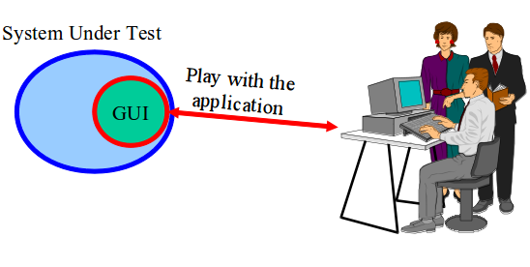
Automating Exploratory Testing
Use tools to streamline bug reporting and reproduction, snapshots, preparation of executable test suites for future use.
A tool captures and records the activities performed by the tester.
Called capture and replay tools.
Notes:
We can use (1). We still conduct exploratory testing as a human, but we use tools to help improve our efficiency and to improve reproducability of the results. In this methodology, usually, a tool, which captures and records every single activity performed by a tester and is installed on the resource’s PC.there is no change in the way the tests are executed apart from crafting the test result based on the captured session. These test results can be used for reporting and reenacting recorded actions later in time. (last point)

Slide 16
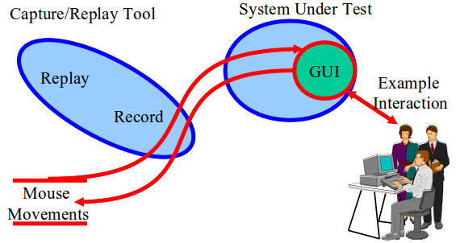
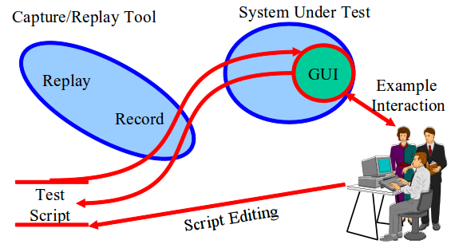
Capture and Replay Tools
Record input during exploratory testing.
The “Capture”
Capture can be replayed to reproduce outcomes.
Capture scripts can be extended and altered to form new test cases.
Notes:
What we can do is get a human in to play with the program. We can record the actions they during exploratory testing. Those are called captures. We can then use those - we can replay them - to repeat the same scenarios and the same mouse motions and clicks without needing the human sitting there again. This aids reproduction of events. If there is a bug, we can see if the same actions trigger it again. These captures - these sets of actions - can also be used as the basis for creating more tests as well. The actions taken during exploratory testing become an initial set of test cases. We can then edit those to turn them into new test cases - modifying the actions slightly or taking the individual actions and combining them to form entirely new tests. This lets us automate GUI testing to some extent as well and fill in some gaps from exploratory testing. Capture a few manual executions, and reuse them or alter them. slightly More productive use of human effort.

Slide 17
Automating Exploratory Testing
Provides clear steps to reproduce failure.
Can also judge performance.
Often used in pair exploratory testing.
Second tester watches replay from first tester.
Second tester looks for ways to extend the tests.
First tester does the same with second tester’s replay.
Exchange again at the end to confirm results.
Notes:
It also has few other benefits like: Provides clear steps to reproduce the failures. Reproducing failuress is easier even when the reporter is not available. Also Helps in performance testing by getting the system response time at the specific point in time. It is advisable to use capture/replay tools with Pair Testing. In this approach,one tester creates a capture and the second tester executes the captures created by the first tester. Then, they look for ways to extend the existing work with new actions or improvements. Testers involved swap roles again at the end so that the tester who created the test script has a chance to re-execute the scripts to confirm the reliability & robustness of the final extended suite.

Slide 18
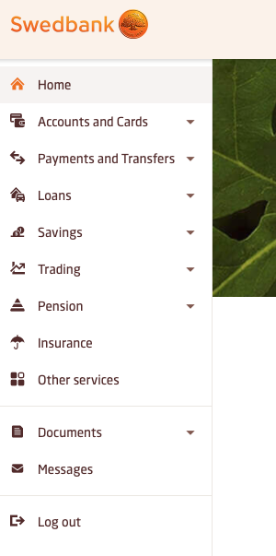
Example System
Banking Webapp
How would you perform exploratory testing?
Scenarios you would try?
Features you would focus on?

Slide 19
Tours in Exploratory Testing
Notes:
10 minute break

Slide 20
Using “Tours” in Exploratory Testing
A tourist seeks to visit as many districts of a city as possible within the time budget.
In software, the “city” is the system, and the “districts” are aspects of the system.
A tour is a plan for exploratory testing.
Includes a set of objectives, based on visiting different “districts”, to focus on during testing.
Should take less than four hours.
Notes:
While performing exploratory testing, test engineers resemble tourists who arrive in the place where they have never been before. Suppose you are visiting a large city like London for the very first time. It’s a big, busy, confusing place for new tourists, with lots of things to see and do. Indeed, even the richest, most time-unconstrained tourist would have a hard time seeing everything a city like London has to offer. The same can be said of well-equipped testers trying to explore complex software; all the funding in the world won’t guarantee completeness. Each city or town has several districts, for Example, business or historical one, and the tourists choose one or several districts to visit based on their schedule. In terms of software testing, The city or town where the tourists come is a software product to test. Districts are aspects of the software. For instance, the business district represents core money-making functionality, while the seedy district represents security of the system. A tour is a plan of exploratory testing activities. Tourism benefits from a mix of structure and freedom, and so does exploratory testing. A testing tour includes the objectives and tasks to focus on during exploratory testing. Usually, the duration of each tour is limited and should not exceed 4 hours.

Slide 21
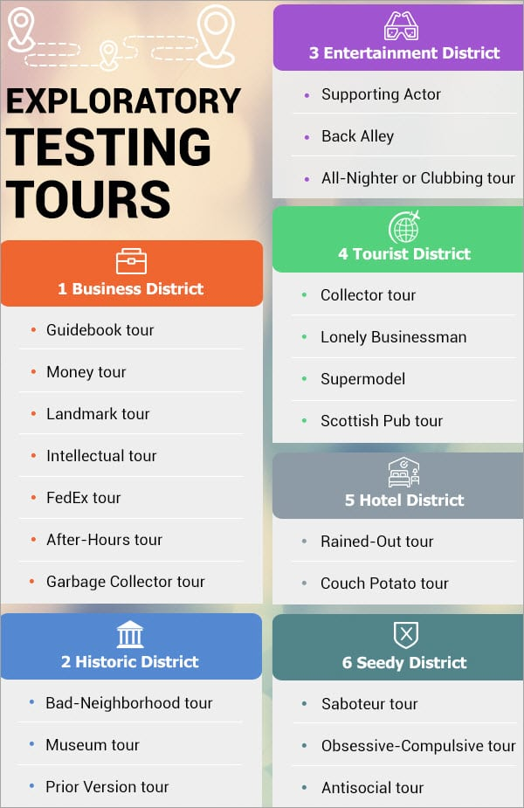
Exploratory Tours
Features split into “districts” based on type and how we test.
Business = core functionality
Seedy = security aspects
“Tours” related to each district.
Each prescribes a way of exploring the software.
Notes:
Any discussion of test planning needs to begin with decomposition of the software into smaller pieces that are more manageable.Features are rarely independent from each other. They often share
application resources, process common inputs, and operate on the same internal data structures. Therefore, testing features independently may preclude finding bugs that surface only when features interact with each other., the tourist metaphor insists on no such decomposition. Instead, it suggests a decomposition based on intent rather than on any inherent structure of the application under test. Like a tourist who approaches her vacation with the intent to see as much as possible in as short a period of time as possible, so the tester will also organize her tours. An actual tourist will select a mix of landmarks to see and sites to visit, and a tester will also choose to mix and match features of the software with the intent to do something specific. Tourist guidebooks will often segment a destination into districts. There’s the business district, the entertainment district, the theater district, the red light district, and so forth. For actual tourists, such segments often represent physical boundaries. For the software tester, they are strictly logical separations of an application’s features, because distance is no real issue for the software tester. Instead, software testers should explore paths of the application that run through many features in various orders. I’m not going to go over all of these, but I’m going to give an overview of each district and once core tour for each.

Slide 22

Business District
Most important features.
The functionality that will get users to buy software.
Tours focus on features that are used most often.
Guidebook Tour: Focuses on common user journeys, covered in user manuals and tutorials.
Fed-Ex Tour: Focuses on how data is passed and transformed between these features.
Notes:
Business districts for cities bustle during the morning and afternoon rush and over the lunch hour. They are where work gets done. They contain banks, office buildings, and usually aren’t interesting places for tourists to hang out. This is not the case for the software tourist. For software, the business district is also “where the business gets done” and is bounded by startup and shutdown code and contains the features and functions for which customers use the software.
These are the “back of the box” features that would appear in a marketing commercial or sales demo and the code that supports those features. The parts of the application that “get the business done” are the reasons that people buy and use software. They are the features that appear in marketing literature, and if you polled customers about why they use your software, these are the features they would quote. Business District tours focus on these important features and guide testers through the paths of the software where these features are used. For example, the guidebook tour focuses on following the step-by-step tutorials offered in user manuals and guides to the software, while the Fed-Ex tour looks at how data is passed from function to function in the software and verified the results of data transformation as it takes different paths through the system.

Slide 23

Guidebook Tour
Cities advertise top attractions, and ensure they are clean and safe.
Software offers user manuals and tutorials, illustrating step-by-step use of features.
Follow tutorials and execute each step.
Tests both functionality and accuracy of tutorials.
If software and tutorial do not match, report an issue.
Notes:
Guidebooks for tourists often boil down the sights to see to a select (and manageable) few. They identify the best hotels, the best bargains, and the top attractions, without going into too much detail or overwhelming a tourist with too many options. The attractions in the guidebook have been visited by experts who tell the tourist exactly how to enjoy them and get the most out of a visit. Cities must ensure that such attraction areas are clean, safe, and welcoming so that tourists will spend their money and return often. From a testing standpoint, hitting such hotspots is just as important, and that makes this tour a crucial part of every testing strategy. Like cities, we want users to enjoy their experience, and so the major features - the ones we use to sell the product - need to be usable, reliable, and work as advertised. The analogous artifact for exploratory testing to a guidebook is the user manual that we provide as part of the documentation. For this
tour, we will follow the user manual’s advice just like the wary traveler, by never deviating from its lead. The guidebook tour is performed by reading the user manual (or other tutorials we offer) and following its advice to the letter. When the manual describes features and how they are used, the tester heeds those directives. If there is a step-by-step guide, we perform each step in sequence. The goal is to try and execute each scenario described in the user manual as faithfully as possible. Many help systems describe features as opposed to scenarios, but almost all of them give very specific advice about which inputs to apply and how to navigate the user interface to execute the feature. Thus this tour tests not only the software’s ability to deliver the functionality as described but also the accuracy of the user manual. The guidebook and its variants test the software’s ability to deliver its advertised functionality. It’s a straightforward test, and you should be alert for deviations from the manual and report those as bugs. It may end up that the fix is to update the manual, but in any event you have done a service for your users. The guidebook tour forces you to string together features of the software much the same way as a user would string them together and forces those features to interact. Any bugs found during this tour tend to be important ones.

Slide 24
Guidebook Variants
“Blogger’s Tour”
Follow guides and scenarios from StackOverflow, blogs, books, other tutorials.
“Pundit’s Tour”
Create tests based on complaints.
Try to reproduce their issues.
“Competitor’s Tour”
Perform tour on competing products and their guides.
Identify potential improvements to your system.
Notes:
There are Variations of this tour, where we step past our own material, and look at what others have written. In the Blogger’s tour, you follow third-party advice. You’ll find descriptions of the software, advice, and tutorials found on stack overflow, in online forums, beta communities, blogs, or if your application is big and widely distributed like Microsoft Office, in actual books. Follow third-party tutorials and scenarios and see if they are accurate and the software can be used problem-free. In the Pundit’s tour, you create test cases that describe the complaints of unhappy reviewers. See if you can either reproduce their issue or understand their complaint, perhaps leading to proposed changes to the software.
Another useful variant is the Competitor’s tour, where you follow any of the above artifacts’ advice for competing systems. In this case, you are not looking for bugs exactly, but are looking for ways you can improve your own product, like ways the competitor is more usable, works more smoothly, or has a better version of a feature you also offer.

Slide 25

Fed-Ex Tour
When a package is sent, it is handled by many people and passes through many locations.
In software, data is passed, transformed, and passed again before output appears.
Examine how data is manipulated.
Validate data after operations.
Look at serialization/deserialization.
(ex: how does shopping site handle mailing addresses?)
Notes:
FedEx is a company that does package-delivery. They pick up packages, move them around their various distribution centers, and send them to their final destination. For this tour, instead of packages moving around the planet through the FedEx system, think of data moving through the software. The data starts its life as input and gets stored internally in variables and data structures where it is manipulated, modified, and used in computation. Finally, much of this data is finally “delivered” as output to some user or destination - some other part of the system or an external system. During this tour, a tester must concentrate on this data. Try to identify inputs that are stored and “follow” them around the software. For example, when a mailing address is entered into a shopping site, how is that address used? What features consume this address? If it is used as a billing address, make sure you exercise that feature. If it is used as a shipping address, make sure you use that feature. If can be updated, update it. Does it ever get printed or purged or processed? Try to find every feature that touches the data so that, just as FedEx handles their packages, you are involved in every stage of the data’s life cycle.

Slide 26
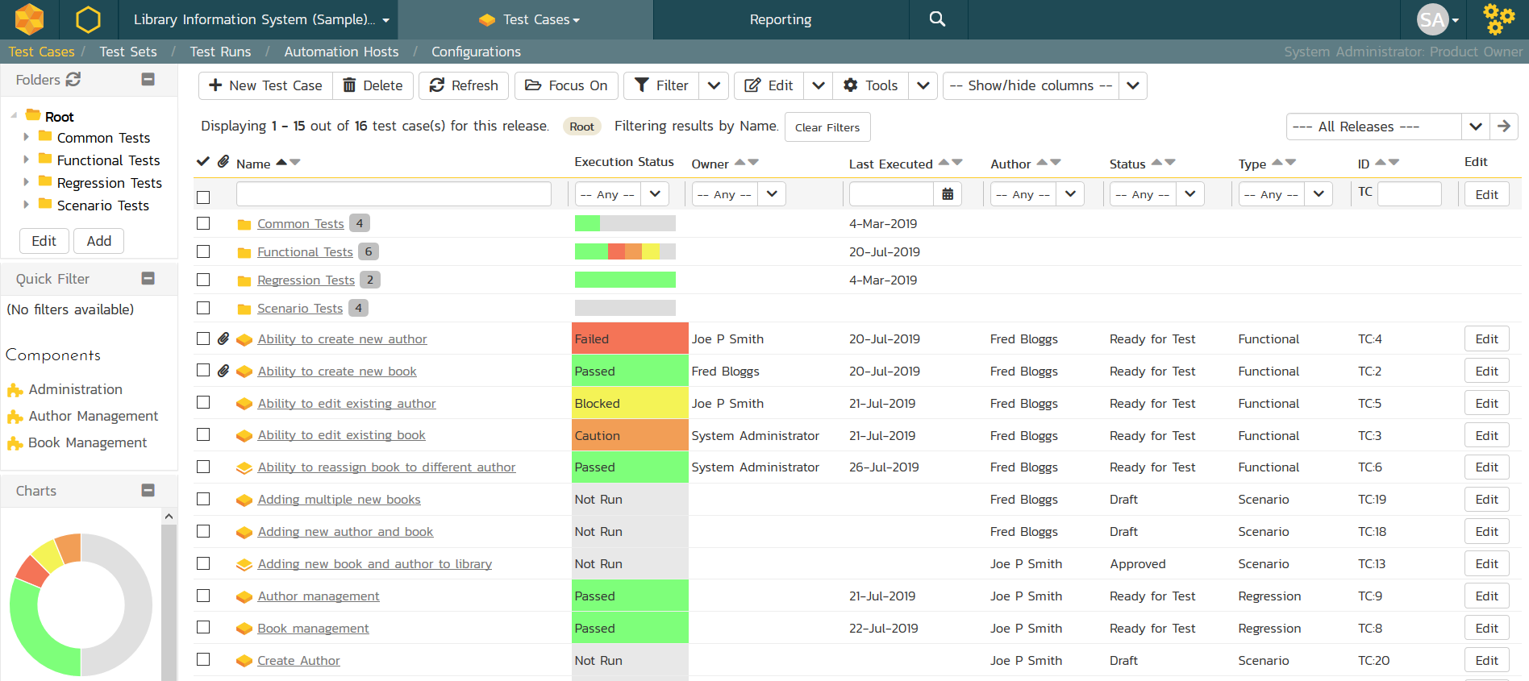
Fed-Ex Tour Example
Test Case Management System
Client app pulls “work items” from a server and displays it in GUI for manipulation.
Test cases, bug reports
Relies on server connection for almost all functionality.
Many clients can modify same work items concurrently.
Notes:
I will be using a lot of examples from Microsoft. They contributed heavily to the book I drew a lot of this material from. Here is a Microsoft system, a test case management system, where they used exploratory tours heavily.
The test case management client works hand in hand with a server, from which it pulls “work items”; things such as test cases, issue reports, test plans and their contents, and so forth to display for a user to manipulate in the GUI. Without the server, the client can basically do nothing. Just by using this piece of information tours such as the Rained-Out tour and the Saboteur, both of which we will talk about soon, yielded a lot of bugs. Imagine canceling a server operation halfway through its completion, or just getting rid of the server itself. Then if you think about it a bit deeper, you realize that a work item (or anything on the server) can be modified at the same time by more than one client. So,
that can lead to many bugs, as well. Updates are happening all the time throughout the application, so the FedEx tour is one to target, asx it looks at information passing through a system.

Slide 27
Fed-Ex Tour Example
Test Case Management System
Must keep data items in sync between clients.
Bug 1: Modify name of test case, go back to view the plan. Must manually refresh to see the updated name.
Bug 2: Modifying the name of a test plan while a second client had it open would crash the app.
Bug 3: If a test plan is linked to a deleted CI build, the app will crash when the plan is opened.
Notes:
the test case management system processes a great deal of data that flows freely between the client and the server: bugs, test cases, test plans, test plan content, and so on. All this information has to be refreshed appropriately to remain in sync, and this is not easy for an application where multiple clients work with the same artifacts simultaneously. The FedEx tour is intended to help a tester think through such scenarios. The following bugs show some defects that the FedEx tour found. • Bug 1: Test plan was not refreshing automatically after coming back from a work item. The test plan contents show the actual test cases in the test plan. the tour suggested modifying properties of test cases (and the test plan itself) and ensuring that all these were refreshed appropriately. It turns out that if they modified the name of a test case, and came back to view the test plan, you had to manually refresh the activity for the test case to show the updated name. They found a number of bugs similar to this second one. • Bug 2: When a test plan is selected, and they modify one of its artifacts, the app would sometimes crashes. In this particular scenario, modifying a property (such as configuration name) of a test plan, while showing that same property on a second open activity, would crash the application because it would not be able to cope with the property change while it was also being displayed. If you think about it, this bug was found using the exact same strategy as the previous one: modifying properties and artifacts, and making sure they were refreshed correctly somewhere else. In this case, it was with two windows on the same client machine. This next one was an interesting bug. • Bug 3: The app will crash forever and ever if they have a test plan that uses a build that has been deleted from the CI pipeline. Their test plans can be bound to builds. However, if they deleted the build that a test plan was bound to, the application would crash every time they opened that particular test plan. Here the point of the FedEx tour is helping us identify those types of data dependencies and guiding us through thinking about such associations between data elements in a system in a methodical manner.

Slide 28

Historic District
Historic districts contain important old buildings.
In software, these are older features still in use.
Tours verify that they still work and are fault-free.
Bad Neighborhood Tour: Ensure that faulty code now works, and that fixes did not introduce new faults.
Museum Tour: Ensure that unchanged code still works as intended.
Notes:
Many cities have historic places or were the setting for historic events. Historical districts within cities are areas that contain old buildings and places of historical note. In cities like Boston, they are distributed around the city and connected by marked walking trails. In Cologne, a small contiguous section of the city is called the “old town” to mark where the city stood before its modern expansion. Tourists love the mystery and legacy of the past and that makes historical districts very popular. For software, history is determined by its legacy code and history of buggy functions and features. The historical district represents areas of legacy code still in use, features that debuted in earlier versions, and bug fixes. The latter is particularly important because when it comes to bugs, history does indeed repeat itself, and it is important to retest previously buggy sections of code. Like real history, legacy code is often poorly understood, and many assumptions are made when legacy code is included, modified, or used. Tours through the historical district are designed to test legacy functionality and verify bug fixes. For example, the bad neighborhood tour is focused on fragments of the software where faults were previously discovered, and ensures that those faultss are solved and gone and looks for new faults exposed by fixing that code. The Museum tour, on the other hand, looks at parts of the program that have not changed in some time and that may not work properly given changes to the rest of the system and may not have been retested. It focuses on verifying that those parts of the system still work.

Slide 29

Bad Neighborhood Tour
Complex features may have had many faults fixed over time.
Focus on those features and ensure that:
Reported faults have actually been fixed.
New faults have not been introduced or uncovered.
Also check related features for introduced faults.
Notes:
Every city worth visiting has bad neighborhoods and areas that a tourist is advised to avoid. Software also has bad neighborhoods—those sections of the code populated by faults. The difference between real tourists and exploratory testers, however, is that the former try to avoid bad neighborhoods, and the testers are advised to spend as much time in them as possible. Clearly, we do not know in advance which features are likely to represent bad neighborhoods. But as bugs are found and reported, we can connect certain features with bug counts and can track where faults are occurring on our product. A tester should check such these buggy areas precisely, ensuring that older issues are actually solved and looking for mistakes uncovered by fixing known bugs. Because bugs tend to congregate around complex features, revisiting buggy sections of the product is a tour worth taking. Indeed, once a buggy section of code is identified, it is recommended to take a tour through nearby features as well to verify that the fixes didn’t introduce any new bugs in those either.

Slide 30
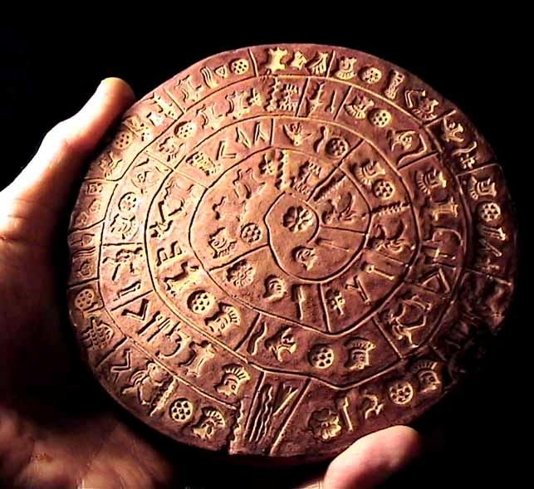
Museum Tour
Older features may not have been modified or retested recently.
Verify that old code still works in the current system.
Check modification dates in repository, and ensure oldest elements are retested.
Such elements often lack tests, are hard to modify, not tested up to current standards.
Notes:
Museums that display old artifacts are a favorite of tourists. Famous museums draw many thousands of visitors on a daily basis. Antiquities within a code base deserve the same kind of attention from testers. Features or aspects of this code may not work in a new environment. For Example, an Android version of the application might have operated properly in Honeycomb, but some features cause crashes in a newer version like Android 11 even if everything seems to compile. In this case, software’s antiquities are legacy code - older features that we continue to use, but have not been modified or retested in some time. Untouched legacy code is easy to identify by a quick perusal of the time stamps in the code repository. Source repositories also maintain a modification record, so testers can do a little research to see what older code may contain some recent modifications. Older code files that undergo revision or that are put into a new environment tend to be failure prone. With the original developers potentially long gone and documentation often poor, legacy code is hard to modify, hard to review, and evades the unit testing net of developers (who usually write such tests only for new code). During this tour, testers should identify older code and executable artifacts and ensure they receive a fair share of testing attention.

Slide 31
Let’s take a break.
Notes:
15 minute break

Slide 32
Entertainment District
Entertainment districts fill in the gaps in a vacation when you want to relax.
In software, this represents supporting features that aren’t part of critical functionality.
Word processor: Making document look nice.
Tours visit supporting features and ensures they are properly intertwined with core features.
Supporting Actor: Features on-screen with core features
All-Nighter Tour: Run the software for a long time.
Notes:
On every vacation, tourists will need a break from their busy schedule of fighting crowds and seeing the sites. Visiting the entertainment district, taking in a show, or having a long quiet dinner out is a common way of doing this. Entertainment districts aren’t about seeing sites, they fill in the gaps of a vacation and give a local flavor to relaxation. Most software has features that serve these purposes. For example, the business district for a word processor is the set of features to construct the document, write text, and insert graphics, tables, and artwork. The entertainment district, on the other hand, is the filler features for laying out pages, formatting text, and modifying backgrounds and templates. In other words, the work is in making the document and the “fun” part is making it look nice and represents an break from the actual work. Tours through the entertainment district will visit supporting rather than mainline features and ensure that the two are intertwined in useful and meaningful ways. These tours complement the tours through other districts and fill out the corners of a good test plan. For example, the supporting actor tour focuses on features that share the screen with core features, but aren’t those core features. Their proximity to core features means they will be used often as well. Whereas the all nighter tour examines what happens to the system when it has been running for a long time. Bad things happen over time, memory leaks, data c orruption, race conditions. This tour looks on what happens when you have been using the system continuously for a long period of time.

Slide 33

Supporting Actor Tour
Many features might be linked to a core feature.
When we search for a product (core feature), we see “reviews” and “similar items” (non-core features).
Focus testing on features that share the screen with core features.
Will be used often.
Make sure they can be accessed from the core feature.
Notes:
London is full of interesting sites and really cool buildings. However, at times, your attention might be drawn to the buildings that the guide was not pointing out. Next to a famous church with historical significance, you mgiht find yourself drawn to a short row house of buildings with rounded doors barely more than 5 feet high. Whenever salespeople demo a product or marketing touts some feature of our application, users are liable to be tempted by features nearby those in the spotlight. The Supporting Actor tour encourages testers to focus on those features that share the screen with the features we expect most users to exercise. Simply their proximity to the main event increases their visibility, and we must not make the mistake of giving those features less attention than they deserve. For instance, when we search for an item, we might see items that were purchased along with the top result, along with a review feature. Make sure both of those work properly, as those searching for products - our core feature - might end up looking at or writing reviews as well, or might look at the “similar items” - those supporting features. If a menu of items is presented and the second item is the most popular, choose the third. Whereever other testers are looking, look a few degrees left or right to make sure the supporting actors get the attention they deserve. In particular, make sure that they can be accessed from the core feature and that this transition works - thatwe don’t have issues accessing these features, as they will likely most often be accessed via the core feature they are linked to.

Slide 34

Tourist District
Captures the experience of being a tourist - visit functions quickly and avoid deep inspection of individual features.
Souvenir Tour: Run quick tests on functions, examine actions and identify gaps, plan round 2.
Supermodel Tour: Test the GUI thoroughly, look for GUI errors, inconsistencies, usability errors.
Notes:
Every city that focuses on tourism has a section of town where tourists congregate. It’s full of souvenir shops, restaurants, and other things to maximize spending and ensure the profits of the local merchants. There are collectibles for sale, services to be bought, and pampering to be had. Locals and those who live in the city avoid these congested areas. Software is similar in that novice users will be attracted to features and functions that an experienced user has no more use for. Tours through the tourist district take several flavors. There are short trips to buy souvenirs, which are analogous to brief, special-purpose test cases. There are longer trips to visit a checklist of destinations. These tours are not about making the software work, they are about visiting its functionality quickly…just to say you’ve been there. They capture the experience of being a tourist in a place for the weekend. for example, the collector’s tour is based on the idea of buying souviniers. We try a bunch of major features quickly, and collect a bit of output - just as we collect something from a place we visit. The idea is to quickly build some bredth. Then, we look over what we have done and the output of it and plan round 2 - identify some ideas on what we missed and would like to hit. Then, we do round 2 based on those ideas of what we missed. Then, we look over the results and plan round 3. This creates an iterative process of exploration where we brainstorm based on what we uncovered so far. Then we have the supermodel tour, wehre we focus specifically on the user interface alone and assess it in detail, without worrying about whether the functionality is correct -we look for rendering errors, inconsistent UI elements, and usability issues.

Slide 35
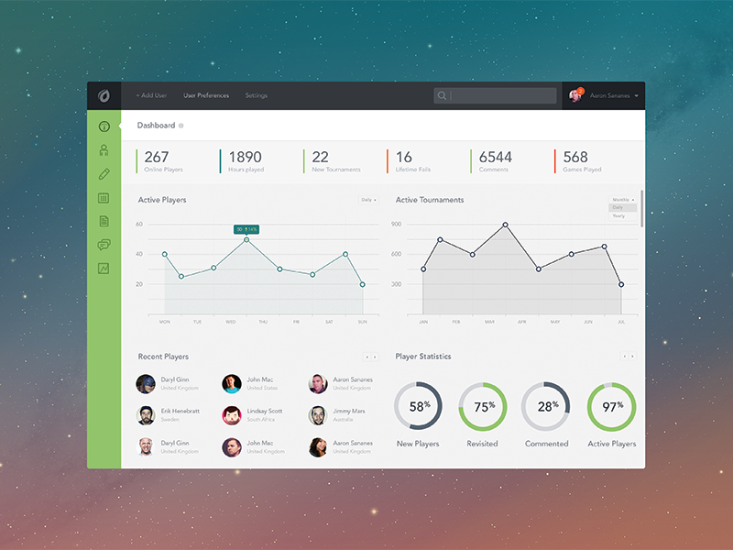
Supermodel Tour
Ignore the functionality and focus on the GUI.
As you try different functions:
Does GUI render properly and quickly?
Are transitions clean?
Are colors and styles used consistently?
Is GUI usable and accessible by those with dyslexia or colorblindness?
Notes:
For this tour, I want you to think superficially. Whatever you do, don’t go beyond skin deep. This tour is not about function or substance; it’s about looks and first impressions. Think of this as the cool tour that all the beautiful people take; not because the tour is meaningful or a great learning experience. On the contrary, you take this tour just to be seen. Get the idea? During the Supermodel tour, the focus is not on functionality or real interaction. It’s only on the graphical interface. Take the tour and watch the interface elements. Do they look good? Do they render properly, and is the performance good? As you make changes, does the GUI refresh properly? Does it do so correctly or are there unsightly artifacts left on the screen? If the software is using color in a way to convey some meaning, is this done consistently? Are the GUI panels internally consistent with buttons and controls where you would expect them to be? As we go to different screens, do we use elements of the GUI in a consistent manner? Does the interface violate any conventions or standards? Is it accessible to people who are colorblind or have dyslexia issues? Software that passes this test may still be buggy in many other ways, but just like the supermodel…it is going to look really good. The Supermodel tour is used extensively, and is one of the three tours used on every project at Microsoft.

Slide 36
Supermodel Tour Example
Dynamics AX Client
Resource planning system acquired by Microsoft.
Shift from APIs to heavy GUI development.
Led to take-up of exploratory testing.
Found MANY bugs missed by API tests.
Many new scenarios and interactions not considered before.
Testers learned that they knew very little about their own app.
Now: exploratory testing before new features merged.
Notes:
To give an example of how this tour was used in practice, we can look at Dynamics AX. This is an enterprise resource planning, or ERP, system that was implemented more than 20 years ago and was acquired by Microsoft. After the acquisition, development shifted heavily towards improvements of the graphical interface - providing forms, controls, and shells over the underlying functionality. The team shifted from testing public APIs to testing through a GUI. This led to heavy use of exploratory testing. When they made this transition, we learned several things: Many of the bugs that we found were not being caught by the API test cases. Testing through the GUI introduced a seemingly infinite number of scenarios and complex user interactions that were not easily captured using automated tests. they also learned that Dynamics AX is a massive application and there was a lot about it we did not know, let alone how it should be tested. Now, they perform exploratory testing before new features are checking in to the repositroy and use it to develop new test cases and test designs.

Slide 37
Supermodel Tour Example
Actions that exposed DynamicAX issues:
Modify OS settings (brightness/contrast/resolution) and verify the elements display properly.
Access remotely and look for flickering or bad rendering.
Run with multiple monitors.
Combine with Supporting Actor Tour:
Open pop-up, but look for GUI issues around pop-up.
Appearance faults often have major impact on user perception of the program.
Notes:
The Supermodel tour was vital for eliminating glaring flaws in the interface of Dynamics AX. With respect to a GUI, it’s important to verify how features of the external environment affect the appearance of an application. Here are a few examples: • Modify the OS display settings, such as to high contrast, and verify that all controls, icons, and text display properly. • Use Terminal Services to remote into the machine that has the application installed and verify that there is no painting or flickering issues as windows in the application are drawn. • Run the application with dual monitors and verify that menus and windows display in the correct monitor.
They also combined it quite a lot with the Supporting Actor tour. While perusing the interface, always take care to look beyond the current window or control that you are primarily focused on to see how the rest of the application appears. This technique is comparable to the Supporting Actor tour, where you must “turn your attention 10 degrees left or right” to get the full effect. For instance, they found a bug where they opened a pop-up window on a form and the title bar became grayed-out, thereby making it appear as though the entire form had lost focus. While their main attention was on the pop-up window, by taking a step back to look at the entire form, they caught a very subtle bug with the title bar.
Because most first impressions are based on looks alone, bugs involving the appearance of an application can lead to perceptions of an unprofessional, poorly engineered product. Unfortunately, these types of bugs are often deemed as low priority to fix. A handful of appearance-related bugs in an application may seem harmless, but together they often have a cumulative effect on usability and therefore should not be ignored.

Slide 38
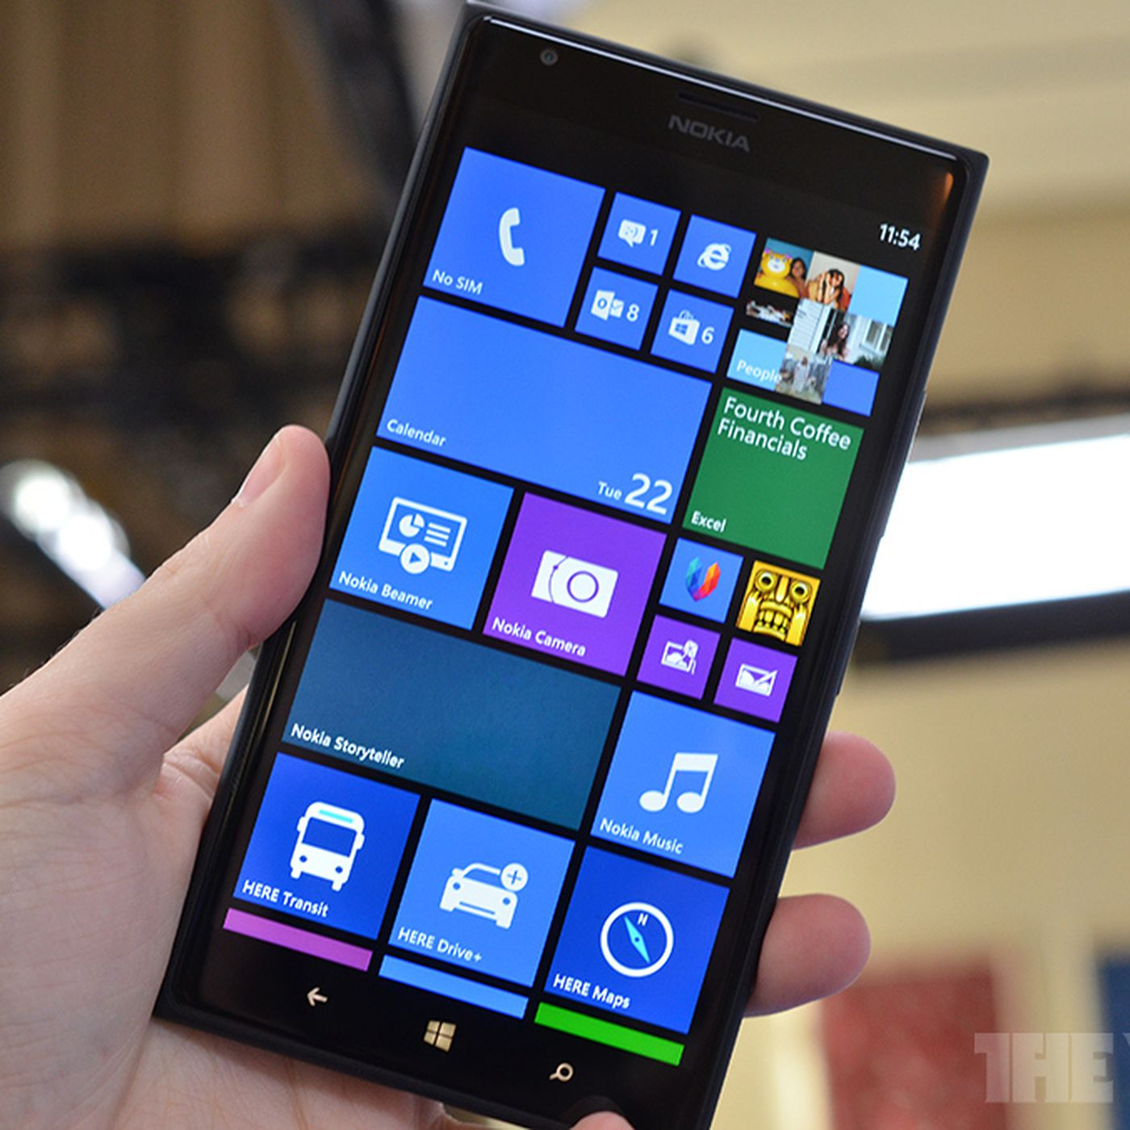
Supermodel Tour Example
Windows Phone
Mobile OS
Always connected, supports mobile, bluetooth, WiFi
Must consider memory, battery life, CPU speed, bandwidth.
Anyone can release apps that can cause potential issues on a device.
Notes:
Here is another Microsoft example, the Windows Phone, their ill-fated competition to Android and iOS. This, of couse, is a smartphone OS that was intended to allow many of the same apps and functionality of a full-size Windows PC on a phone-sizes device. These are complex to test, as you can imagine, as these are fully-connected mobile, bluetooth, and WiFi devices that are constantly sending and recieving new data without the user needing to make a request. Constraints such as memory, battery life, CPU speed, and bandwidth all had to be considered when developing and testing for this platform. In addition, indepedent developers could release apps for the OS. This causes the testing challenge of operating a number of unknown apps on the OS that may, at times, cause unexpected issues and push the boundaries of what a device can do . A number of interesting bugs were found during exploratory testing using these tours, including with the supermodel tour.

Slide 39
Supermodel Tour Example
Windows Phone
Set to an uncommon screen resolution.
Navigated to different calendar views.
When selecting a month, the month “view” was centered when it should have been top-justified.
Missing flag for screen resolution in this view.
Usability of Maps application.
Device knows current location, but does not use it as default when “Location A” field left blank.
Not a bug, but fixing would improve user experience.
Notes:
Here is an example of when they used the Supermodel tour on a Windows Phone device and explored UI centering and anchor points using different resolutions. After booting an image set to a screen resolution that they knew was not used a lot, they navigated around the device performing simple user tasks (for example, creating contacts, checking email, and checking calendar events). During the calendar event navigation, they noticed that when they selected to navigate to a specific date, the calendar week view centered itself onscreen. A number of views could be used, and so they inspected each view. When they got to the month view, they saw a centering issue. After they changed which month to view via the month picker, the repainting of the month that was selected was centered in the middle of the screen, instead of being top justified like every other view. This incorrect centering occurred because of a missing flag in this one view.
A second example of a bug found by using the Supermodel tour coupled with focus specifically on usability and intuitiveness of design. While traversing through a mapping application on Windows Mobile, they decided to see how easy it was to get directions from their current location to another location, such as a restaurant. They launched the application, the device found my current location, and then they decided to select the option to get Directions from A to B from the menu. In this UI, there was no intuitive way to select the current location as their starting point. Given that they did not know the address where they currently were, they just then decided to enter the point B location and hit Go. An error appeared stating it needed to know where they were starting from. Interesting, because upon entering the application, it made it a point to tell them where they were. This lack of completeness can cause a lot of pain when using the application, and a simple addition to prepopulate this field could be the difference between someone using this application all of the time versus it getting bad reviews.

Slide 40
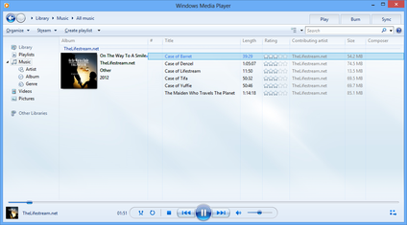
Supermodel Tour Example
Windows Media Player
Media player.
Sync, burn, rip, play many media types.
UI-centric application.
Inputs are text, check boxes, option icons, disc icons.
Output is audio, video, dialog boxes.
Notes:
Windows Media is intended to be a solid, robust, functional, media player that can sync, burn, rip, and playback numerous file types, including pictures and DVDs.
WMP is an application that is UI-centric. As such, it was heavily tested using exploratory testing and tours specifically relating to UI, like the supermodel tour. To be specific, WMP’s input
sources are via text boxes, check boxes, option buttons, and “shiny disc” icons (CDs, DVDs, and CD-R[W]s), while its output is as audio, video, and dialogs displayed to the user. Both must be both functionally correct and display correctly at all times.

Slide 41
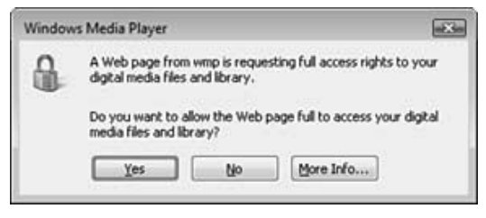
Supermodel Tour Example
Windows Media Player
Supermodel tour gave most rapid results to testers.
Many typographical mistakes found early in development.
Look at text and read slowly.
(count to two before going to the next word)
These faults are not *serious*, but will harm your reputation if there are many of them.
Notes:
They found the supermodel tour very useful in testing Windows Media Player, and noted that it was their top for quantity of failures found quickly. The first things they found with supermodel tour were typographical errors. Early on in the product cycle is when this category of faults is more common. To effectively spot text faults, one should read each word and then count to two before reading the next word. Spot the bug here? It’s hard to read, I know. So, It is in the second paragraph. “Do you want to allow the Web page full to access your….” (click) This should be, “Do you want to allow the Web page full access to your….” It is easy to read too fast and correct the sentence in your head while not seeing the error in front of your eyes - so that’s where that read slowly trick comes in

Slide 42
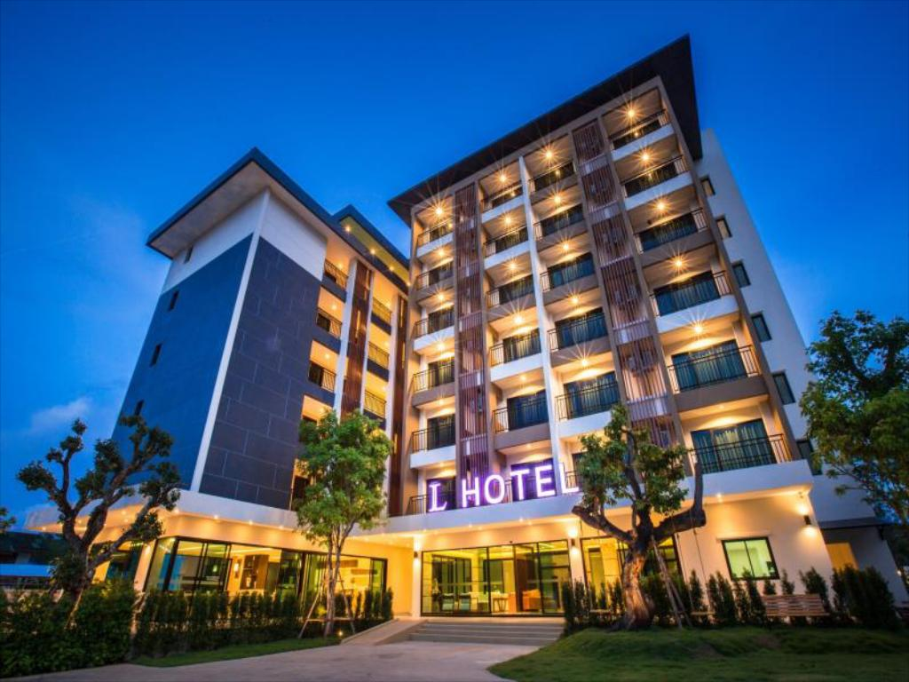
Hotel District
Return to hotel to take a break.
Focuses on secondary and supporting usage scenarios.
Software “at rest” can be very busy.
Rained Out Tour: Cancel running operations and see if problems are caused.
Couch Potato Tour: Leave fields blank and use default values to assess ability to process partial information.
Notes:
The hotel is a place of sanctuary for the tourist. It is a place to get away from the hustle and bustle of the vacation hotspots for a little rest and relaxation, to recover from their busy day or wait out lousy weather. This is a place for the software tester to get away from the primary functionality and popular features and test some of the secondary and supporting functions that are often ignored or under-represented in a test plan. As we shall see, software is actually quite busy when it is “at rest,” and these tours seek to test those features. For example, the rained-out tour looks for features that can be cancellend once started, and examines what happens when we cut a long-running operation in progress. The couch potato tour looks at what happens when the tester does the least interaction possibel - Leave default values in place, leave input fields blank. Ensures the software must execute code for processing blank or partial information, must handle defaults properly.

Slide 43

Rained-Out Tour
Look for operations that can be cancelled.
Cancel midway through, see if everything still works.
Good for finding failures related to the program’s inability to clean up after itself.
Open files, corrupted memory or state.
Even if there is no cancel button, can click back button or close entirely.
Notes:
We’ve all gone places and had it start raining, right? Then you have to decide whether to press on or cancel. If you’ve taken a tour in London between the autumn and spring, it can be a wet, rainy affair, and you may well find yourself tempted to cut the tour short at the second stop. For the tourist, it may be worht pressing on. You are already wet. But for the exploratory tester, you can hit that that cancel button. The idea behind the Rained-Out tour is to start operations and stop them before they complete. We may enter information to search for flights on a travel website only to cancel them after the search begins. We may print a document only to cancel it before the document is complete. We will do the same thing for any feature that provides a cancel option or that takes longer than a few seconds to complete. Exploratory testers must seek out the time-consuming operations that their application possesses to use this attack to its fullest. Search capabilities are a common example, and using queries that require a lot of processing is a tactic that will make this tour a little easier. every time a cancel button appears, click it. If there is no cancel button, try the back button for apps that run in a browser or on Android. You can even close the application completely. And try this, too: Start an operation, and then start it again without stopping the first. The failures you will see on this tour are mostly related to the inability of the application to clean up after itself. There are often files left open, data left clogging up internal variables, and a state of the system that is no longer tenable for the software to do much else. So after you hit cancel (etc.), take some time to poke around the application to make sure it is still working properly. At the very least, you want to make sure that whatever action you canceled should be able to be exercised again and complete successfully. After all, one would expect a user to occasionally cancel something and then try again See what happens - can you cause negative side effects when operations are killed in-progress?

Slide 44
Rained-Out Tour Example
DynamicsAX
Change the state of the software before cancelling.
E.g., open a form and enter information, then close it.
Opened a pop-up within a form, then closed the form while pop-up was open.
App crashed because pop-up was still open.
After opening “User Setup” form, they left it open and switched to a different module.
Crash when they clicked Setup form’s cancel button.
Notes:
The RainedOut tour was also used to find bugs in the DynamicAX client software. The Rained-Out tour concentrates on terminating functionality and verifying that the application continues to behave correctly. There are two tips that I want to emphasize them here because they truly are very helpful in detecting bugs. First, it is important to change the state of the object under test before canceling out of it. Let’s use a form as an example: Do not just open a form and immediately close it. Instead, alter either the form’s or application’s state before closing it. To demonstrate this, here are some actual bugs that they have found in Dynamics AX using this technique: • They opened a form and then opened a pop-up window that was parented by the form. With the pop-up window still open, they clicked the form’s X button to close it. As a result, the application crashed because the form failed to properly close the pop-up window before closing itself. • After opening the User Setup form,they left the form open and switched to a different module in the application. Next, they clicked the User Setup form’s Cancel button, which caused the application to crash.

Slide 45
Rained-Out Tour Example
DynamicsAX
Reattempt scenario after cancelling.
New feature ensures that creates/updates/deletes for joined data occur within a single operation.
Cancel changes by clicking “Restore” button on toolbar.
Changes discarded and replaced by values in database.
Reattempted to update same record, leading to crash.
Notes:
Second, it is imperative to reattempt the same scenario after canceling out of an operation. They used this very technique while performing exploratory testing for a new feature and found yet another client-crashing bug. This new feature ensures that creates, updates, and deletes for inner/outer joined data sources occur within a single transaction. While testing updates, they decided to cancel (discard) these changes by clicking the Restore button on the form’s toolbar. As a result of clicking Restore,their changes were discarded and replaced by values in the database table. They then reattempted to update the same record again and Dynamics AX crashed. So, explore what happens when you cancel operations and continue using the software.

Slide 46
Rained-Out Tour Example
Test Case Management System
Interrupted server requests and refresh actions can lead to issues.
Bug 1: Canceled initial connection to project. No longer able to manually connect to it.
Bug 2: Switching test suites during loading does not stop loading of the original suite.
Bug 3: Clicking refresh button several times causes slowdown, as each refresh is handled (not just the latest).
Notes:
(1) When you’re working with a client application that works closely with a server, you can assume that any unexpected server activity can cause weird things to happen (both on the server and on the client). Interrupted requests
to a server is tricky business, as is refreshing client-side data. Think about it: If you open a page that starts loading information from a server, and you immediately click Refresh, one action is canceled, and a new one starts immediately. The software on both sides of such a transaction needs to handle this. That’s why this tour finds tons of bugs in client-server applications. For example, • Bug: If they cancel initial connect to a project, they can no longer connect to it manually.
Whenever the test case management system is launched, it remembers the previous server (that contains the test case and test data repository) that the user was connected to and initiates an automatic connection to it. If users want to connect to a different store, they have to cancel this operation. It turns out that the developers didn’t think through the cancellation scenario well and caused an environment variable to be deleted under certain circumstances; so when they loaded a new version of the test data repository, the connection to the server was lost. • Bug 2: Plan Contents: Moving between test suites does not cancel the loading of tests. It turns out that whenever they chose a test repository, the application would start loading the test cases that were associated with it. The tour led a tester to think that there had to be an implicit cancel action whenever they quickly chose a different repository, and if not, there would be performance issues. It turned out to be true; they were not canceling the action properly, and performance was really bad. It continued to load the contents of the old repository, even when it should have stopped and switched immediately.
The Rained-Out tour makes it clear to the tourist: Cancel every action you can, and cancel it many times and under many different circumstances. It is raining, so scream and yell for everyone to cancel their plans! This strategy led to bugs like the third: Time to refresh starts growing exponentially as we try to refresh several times. Knowing that a refresh action should basically cancel any in-progress activity, they decided to click that Refresh button many times (quickly), and this actually caused horrible performance issues in the product.

Slide 47
Rained-Out Tour Example
Windows Phone
Search for contact
Loaded > 4000 contacts. While searching, they changed the search string.
Changed filter clashed with original filter, incorrect results.
Bluetooth Connection
If focus shifts while connecting to device, can try to connect again
Multiple connection requests will be sent.
Device functions once connected, but multiple failure notices come back.
Notes:
While performing exploratory testing on a previous release of Windows Phone, they caught a race condition with “smart dial” functionality. In this instance, it was known that a side process was being used to do a background search on the search criteria to aid with performance. The larger the data set, the longer it takes this process to complete. This turned out to be an excellent opportunity to use the Rained-Out tour. After loading more than 4,000 contacts onto the device under test, they entered a search string that was expected to end in no results. As the side process was processing in the background, they changed the search string by deleting one character. The expected result was to still have no matches, but the side process was not done with checking the entire data set, and therefore the next filter, which is designed to check the results of the initial side process, was passed the data that was not checked yet. This resulted in an incorrect IF statement, and data that did not match the search clause was displayed incorrectly. Another example of using the Rained-Out tour is in an issue found and then fixed in the Bluetooth settings. After creating bonds with a few headsets and peripherals, they proceeded to use the Rained-Out tour during the connection-request phase. When the listed peripherals were all disconnected, there was an option to connect one of them to the phone. They selected one of the BT peripherals and selected the Connect option. They then noticed a time delay between when the connection request was made and when the connection or the failure dialog was actually shown. During this time, They tried all the available menu items. They all functioned properly during this state. It wasn’t until they moved focus away from the existing item, then back to the item with the current connection request, that they noticed that the connection option became available again. So as a tester using the Rained-Out tour, they selected that option. Doing so keyed up another connection request to the same peripheral. They performed the same steps a few more times in quick succession before the initial connection request completed, and a sequence of failure dialogs popped up. Ultimately, the code was able to handle this situation, but there was no need to be able to continue to make multiple connection requests to the same peripheral, This created a performance issue and an annoyanc for the user.

Slide 48

Couch Potato Tour
Tester does least interaction possible.
Leave default values in place, leave input fields blank, try to move forward without offering much data.
Ensures software must execute code for processing blank or partial information and defaults.
We try so many complicated scenarios that we can miss or forget the defaults.
Notes:
There’s always one person on a group tour who just doesn’t participate. She stands in the back with his arms folded. He’s bored and makes one wonder exactly why he bothered paying for the tour in the first place. However, on such tours, the guide is often prompted to work harder to try to draw the couch potato in and help her enjoy the tour. From the tourist’s perspective, it sounds like, and probably is, a waste of time. But it’s exactly the opposite for software testers. Couch potatoes can make very effective testers! The reason is simple, even if it is not intuitive: Just because the tester isn’t doing much does not mean that the software follows suit. Like the diligent tour guide, it’s often the case that nonactivity forces software to work very hard because it is busy executing the “else” clauses in IF-THEN-ELSE conditions and figuring out what to do when the user leaves data fields blank. A great deal of “default logic” executes when a user declines to take the initiative. A Coach Potato tour means doing as little actual work as possible. This means accepting all default values (values prepopulated by the application), leaving input fields blank, filling in as little form data as possible, never clicking on an advertisement, paging through screens without clicking any buttons or entering any data, and so forth. If there is any choice to go one way in the application or another, the coach potato always takes the path of least resistance. As lazy as this sounds, and granted the tester does little real interaction, this does not mean the software is not working. Software must process default values, and it must run the code that handles blank input. That code doesn’t execute itself, and missing default cases are far too common and very embarrassing in released products because testers are too focused on specific cases.

Slide 49

Seedy District
Focused on attacking and breaking the system.
Saboteur Tour: Directly attack software via malformed input or resource manipulation.
Antisocial Tour: Try unlikely input or perform actions in the wrong order.
(add 10000 songs instead of one, try to play an empty playlist, order 0 or 10000000 pairs of shoes)
Notes:
Finally, we have the Seedy District. Seedy districts are those unsavory places that few guidebooks or visitors bureaus will document. They are full of people doing bad and illegal things and are better off left alone. Yet they attract a certain class of tourist anyway. Seedy tours are a must for testers because they find places of vulnerability that may be very unsavory to users should they remain in the product. This is the bad part of town, where we have input meant to break the software, meant to cause trouble for the legitimate users. In the Saboteur Tour, we attempt to break the software by feeding in malformed input, removing or restricting resources, or thinking of other ways to creatively disrupt operations. In the Antisocial Tour, we try unlikely input - legal, but unlikely. We add 10000 songs to a playlist, or play an empty playlist, or we try to order 1000000000 pairs of shoes. Or we use legal input, but try to perform actions in the wrong order.

Slide 50
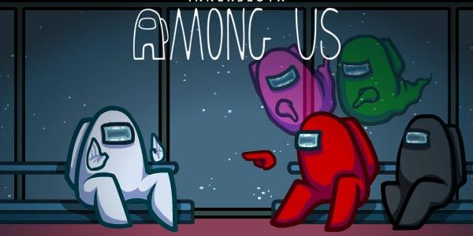
Saboteur Tour
Force the software to act.
Understand the resources it requires to successfully act.
Remove of restrict those resources.
Use corrupt input data, limit network connectivity, allow too little RAM, run many other apps at the same time.
Think of ways to creatively disrupt operations and try them out.
Notes:
During the Saboteur Tour we will attempt to undermine the application at every possible opportunity. We will ask the application to read from the disk (by opening a file or using some disk resource), but then sabotage its attempt to do so by rigging the file operations to fail (perhaps by corrupting the file in question). We will also ask it to do some memory-intensive operation when the application is either on a machine with too little memory or when other applications are operating in the background and consuming most of the memory resources. We try to hide injected code in xml or cut off the internet connection mid-operation. This tour is simple to conceptualize: • Force the software to take some action. • Understand the resources it requires to successfully complete that action. • Remove or restrict those resources in varying degrees. During this tour, a tester will find that there are many ways to rig environments by adding or deleting files, changing file permissions, unplugging network connections, running other applications in the background, deploying the application under test on a machine that has known problems, and so forth.

Slide 51
Saboteur Tour Example
Test Case Management System
Change or remove necessary resources.
Bug 1: System crashes if connection to data server is closed at different points.
Bug 2: System crashes, restarts, crashes again, etc. if the config file is corrupted.
Bug 3: System crashes if config file is too large.
(also try making it read-only, changing file type, deleting)
Notes:
The Saboteur forces you to think though the application’s use of resources so that you can vary the amount of resources available, and potentially find scenarios that will cause it to fail, for example: • Bug: System crashes when trying to view a test configuration when there is no connection to the server used to store test cases and test data. The Saboteur causes you to think through many scenarios where availability of a server was crucial and where good error-handling routines need to be in place. Making the server unavailable at the right time sometimes will lead to serious crashing bugs, and the resulting fixes will make your product more robust with respect to server connection problems. In this next bug, the strategy was the same one: looking for a resource that the application uses. • Bug 2: system crashes at startup time if the config settings file becomes corrupt. The system continually fails until the config file is corrected. The resource in this case was a file that the application uses to persist data between sessions. The Saboteur requires that all such state-bearing files be tampered with to see whether the application is robust enough to handle it when those persistent resources are corrupt or unavailable. This next bug shows the exact same strategy as the previous one but with a new twist. • Bug 3: System crashes when config file is really large. Finding this particular bug consisted of playing around with the configuration file and creating variants of it and modifying its properties. The Saboteur suggests making it read-only, deleting it, changing its type, and so forth. But the property that worked in this case was its size. When they created a very large config file, the application was simply not able to cope with it.

Slide 52
Saboteur Tour Example
Windows Phone
Contact lists linked to call history, speed dial, texts, etc.
Delete linking database between contacts and speed dial.
Contacts still on device, so phone thinks data is synced.
However, speed dial is empty.
Airplane mode may not be accounted for.
IM client loses connection when airplane mode turned on.
However, does not realize it was disconnected.
User can still attempt to use client when nothing will work.
Notes:
In Windows Phone, a contact list is linked to a number of other functionalities (call history, text messaging, speed dial, and so on). Knowing this, they used a Saboteur tour and created a list of contacts and some speed-dial entries. Then, A sync error was created where the contacts on the device were all removed from one of the linking databases on the device, but the device still thought they were synced (because the contacts still existed on the device). Therefore, syncing was seemingly successful, but the database that housed the links to the speed dial did not exist anymore, and therefore a blank speed dial was shown.
A good time to use the Saboteur is when testing an application that utilizes data connectivity. Data connectivity is fickle beast and can come and go when you least expect it. Using this tour, they were able to find a problem with a chat client who requires a connection to provide its functionality. They successfully configured this application and signed in. They then terminated the active connection. Then they signed in to the same account on the web app version of the chat client on their desktop, attempting to fully sever the connection to that service on the device. The phone client never got the notification that it was signed in to another location of course but it also appeared to be signed out because it was offline. However, in the menu options, the option to Sign Out was still available (because it never was told it was signed out). This is a common way to sabotage mobile apps. Turn the device’s flight mode on, which turns off all radios. Many times, applications do not listen to radio on/off notifications, and this can cause a limbo state to occur. Sure enough, in this case, signing on to the chat client on the device and then turning off the radio was not detected by this application, and the application is in a perpetual “connected” state, which is quite confusing to the user.

Slide 53
Revisiting the Example System
Banking Webapp
How would you perform exploratory testing?
Scenarios you would try?
Features you would focus on?
Particular tours?
Notes:
(discuss)

Slide 54
We Have Learned
Exploratory Testing
Tests are not created in advance.
Testers check the system on-the-fly,
Often based on ideas noted before beginning.
Testing as a thinking idea.
About discovery, investigation, and role-playing.
Test design and execution done concurrently.
Often by directly using the software and its user interfaces.
Notes:
EXPLORATORY TESTING is a type of software testing where Test cases are not created in advance but testers check system on the fly. They may note down ideas or come up with goals about what to test before test execution. The focus of exploratory testing is more on testing as a "thinking" activity. Exploratory Testing is widely used in Agile models and is all about discovery, investigation, and learning. You can try out different roles and user types. It emphasizes personal freedom and responsibility of the individual tester.
Last class, we talked about uni testing, this is a form of scripted testing where you design test cases first and later proceed with test execution. On the contrary, exploratory testing is a simultaneous process of test design and test execution all done at the same time. (last point)

Slide 55
We Have Learned
Tours apply different focus areas to exploration
Business District: Core features
Historic District: Legacy code and old software versions
Entertainment District: Supporting functionality, long execution sessions
Tourist District: Looks for gaps in the experience, iterative fast rounds of exploration.
Hotel District: Focuses on supporting functionality
Seedy District: Attacks and misuse of software

Slide 56
Next Time
Unit Testing and Test Automation
Pezze and Young, Ch 17
Before Friday’s Exercise Session:
Install an IDE (IntelliJ, Eclipse) and ensure that JUnit is installed and usable.
Assignment 1 due February 14
Questions?
(We will post Assignment 2 soon)

